Slide 1
I. Project Approach and Status

Slide 2
Project Objectives
The Employee Service Center project has three primary objectives:
Establish a seamless, convenient and responsive one-stop inquiry resolution service for Payroll and HR Systems
Define the appropriate Payroll and HR Systems processes and technology to ensure consistent, prompt and quality responses to all employee inquiries
Develop a consistent approach to implementing and managing call centers within Employee Services. This prototype design may potentially expand to all of Business Services
This project includes the design of a prototype employee service center applicable primarily to the Payroll and HR Systems Help Desks.

Slide 3
Overall Project Approach and Timeframe
To achieve these objectives, the project included three phases. This presentation describes findings from the final two phases - design and build (i.e. define the “To-Be”)
Employee Service Center Reengineering Deliverables
“AS IS” ASSESSMENT
Refine, Ratify and Communicate Vision
Identify Best Practices and World Class Performance
Conduct Call Handling Assessment
Conduct Technology Assessment
Perform Activities Analysis
Identify and Assess Controls
Identify “Quick Hit” Opportunities
REDESIGN
Define “To Be” Process
Conduct Gap Analysis
Develop Target Organization
Design Technology Improvements
Prioritize “Quick Hit” Opportunities
BUILD
Implement “Quick Hit” Opportunities
Pilot Process Improvement (If Possible)
Develop Training Implementation Plan
Develop Long Term and Roll-out Implementation Plan
Implement Long-Term Solutions
Integrate with Other Departments
“As Is” and “To Be” assessment of Payroll and Human Resource Systems help desk processes
Technology assessment
World-class Employee Service Center design
Quick-Hit opportunities
Prioritized recommendations for improvement
May-June
June-July
July - August
August - 1997
Objectives of the “To Be” Design and Build
Define “To Be” Process
Develop Target Organization
Develop Technology Recommendations
Validate “Quick Hit” Opportunities
Plan for the Future

Slide 4
Change Imperative Overview
Significant opportunities exist within the Payroll and HR Systems Help Desks to improve customer service.
“As Is” Assessment Themes
“To Be” Design Themes
Poor employee morale and undertrained workforce
People
Highly motivated, skilled and customer focused workforce
Lack of standardized call handling procedures
Process
Standardized call handling procedures
Underutilizing current and/or existing call center technology
Technology
Utilizing best practice call center technology
Numerous unique help desks servicing AlliedSignal employees
Infrastructure
Single point of contact for affected employee-related services
Performance metrics not used effectively to improve service level
Metrics
Timely and continuous use of team and individual performance metrics

Slide 5
Focus of Employee Service Center Reengineering Activities
The “To Be” analysis focused primarily on the following activities:
Developed a strategic vision and design for the Employee Service Center
Conducted an assessment of opportunities identified during the “As Is” phase and categorized each by level of effort and benefit
Updated the process flows to reflect changes made by implementing opportunities (quick hits and selected intermediate-term)
Created a Policies and Procedures Manual for existing processes and included relevant “quick hit” implementations
Developed a high-level business case
Developed a tactical and strategic implementation and training workplan
Conducted a review of best practices (internal and external)
Facilitated visioning sessions with Business Services management and staff

Slide 6
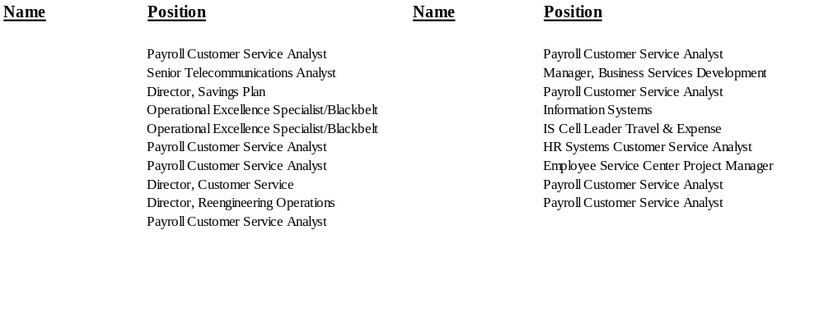
“To Be” Vision Session Participants
The team interviewed numerous AlliedSignal employees to gather visioning information.
Conducted phone interviews with selected stakeholders and random employees with recent Help Desk experience
Also conducted preliminary design sessions with AT&T and Lucent Technologies
NOTE: This analysis refers to Employee Service Center staff as Customer Service Analysts (CSAs)

Slide 7




Employee Service Center Project Documentation Roadmap
The team has provided several deliverables describing activity completed, concurred policies and procedures, and the “To-Be” vision and implementation plan, as described below:
“As Is” Assessment Deliverable
- Process Activities and Cost
- Process Efficiency
- Transaction Analysis
- Organizational Assessment
- Controls Assessment
- Technology Assessment
- Call Handling Flows
- Transaction Cost Analysis
s:\asis_doc\present\1601-mst.ppt
“To Be” Design Deliverable
- “To Be” Design
- Opportunity Assessment
- Recommendations
- High-Level Business Case
- High-Level Implementation and Training
Plan
- Summary and Next Steps
s:\tobe_doc\present\1601bmst.ppt
Policies and Procedures Manual
s:\tobo_doc\pol&pro\p&p-mast.doc
s:\tobo_doc\pol&pro\p&p-covr.doc
Employee Service Center
Quick Hits
Advance Quick Hit Document
- Describes quick hits pursued being
pursued
s:\projmgmt\qhits.doc
Opportunity Assessment Forms
s:\tobe_doc\opp_docs\opp_mst.doc

